Slide 1
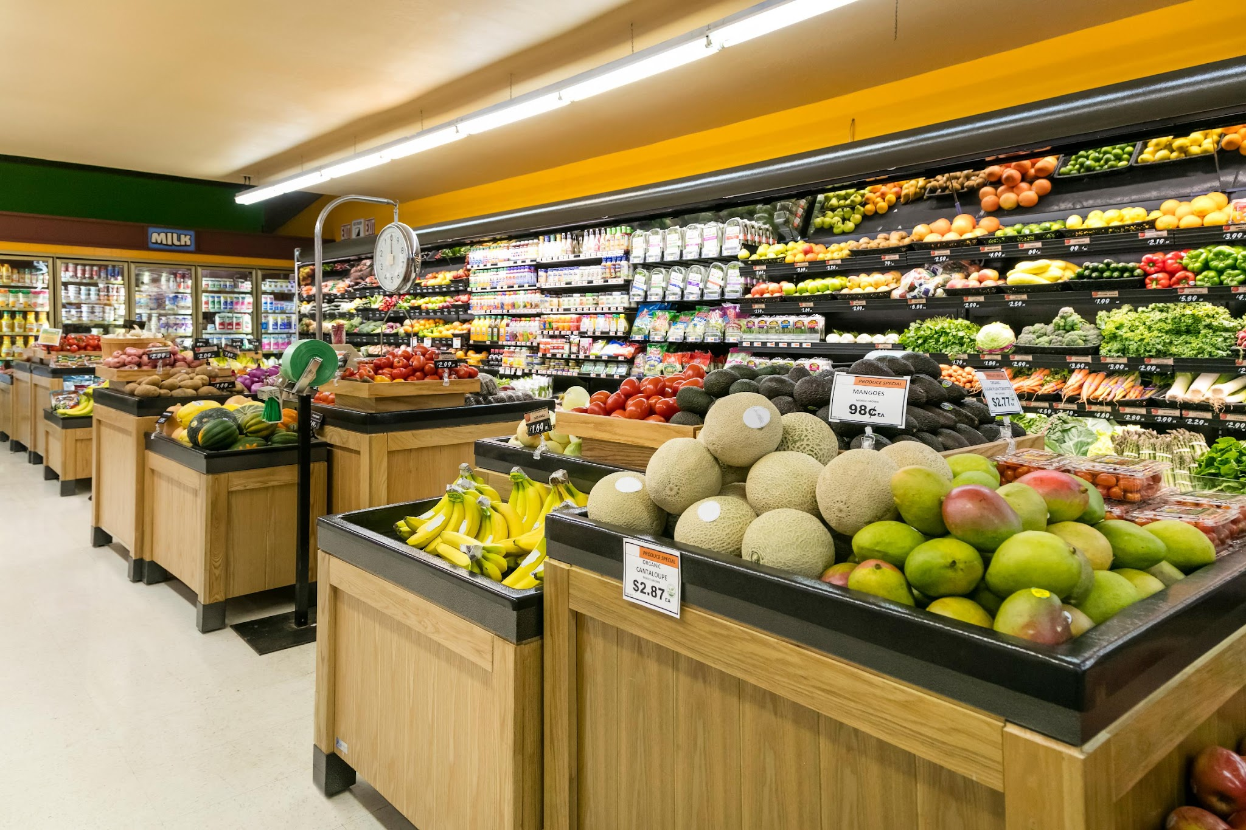
Your Logo
UK Weekly Wholesale Vegetable Price Forecasting
Harleen Buttar, Danilo Ruberti, Minhao Zhang

Slide 2
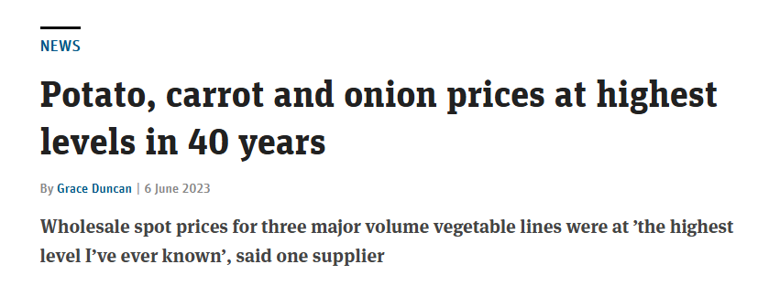
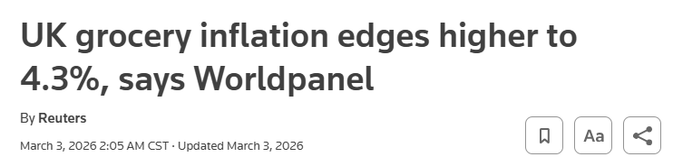
UK Vegetable Price Forecasting
Volatile pricing due to seasonality, supply, and energy-related costs.
Goal: predict weekly UK wholesale vegetable prices for planning and budgeting
Data: DEFRA weekly prices + upstream material cost index as a cost driver
Challenges: strong seasonality, trend, missing weeks, and shock spikes
Success: best 52‑week hold out period accuracy (sMAPE)

Slide 3
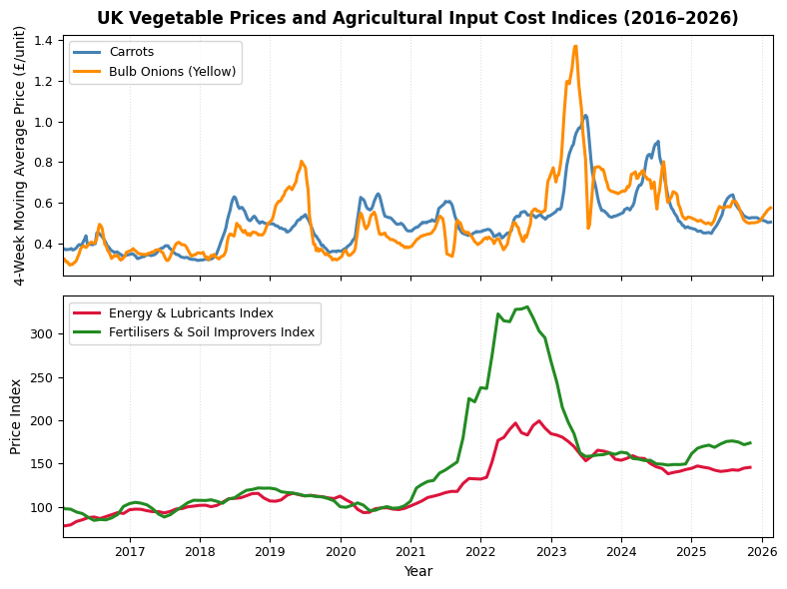
Data Overview
Substantial missing target data and additional index.
UK grocery wholesale prices
Weekly data: 2015‑01‑09 to 2026‑02‑16
9–13% missing data for selected data due to holidays and change in reporting cycle
59 commodities (selected 4 to model)
Exogenous inputs (index)
Energy & lubricants, Fertilisers, Seeds, Plant protection, Diesel/Petrol, Road freight (Mixed Monthly/Quarterly)
https://www.gov.uk/government/statistical-data-sets/wholesale-fruit-and-vegetable-prices-weekly-average
https://www.gov.uk/government/statistics/agricultural-price-indices

Slide 4
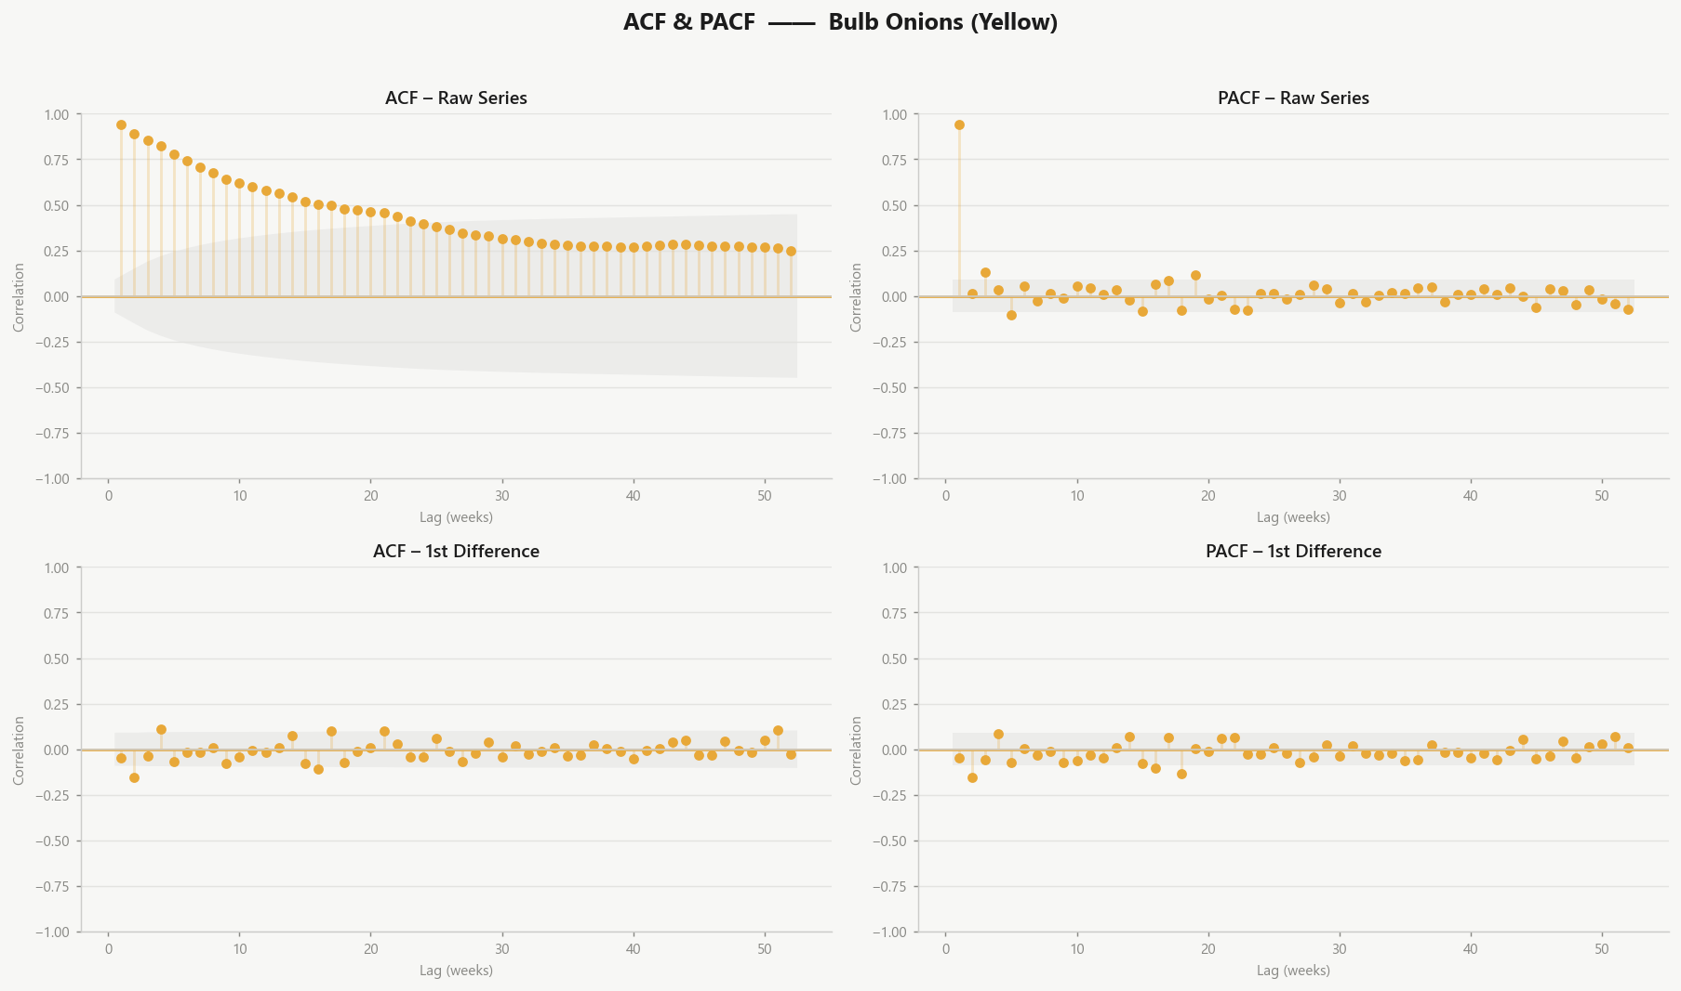
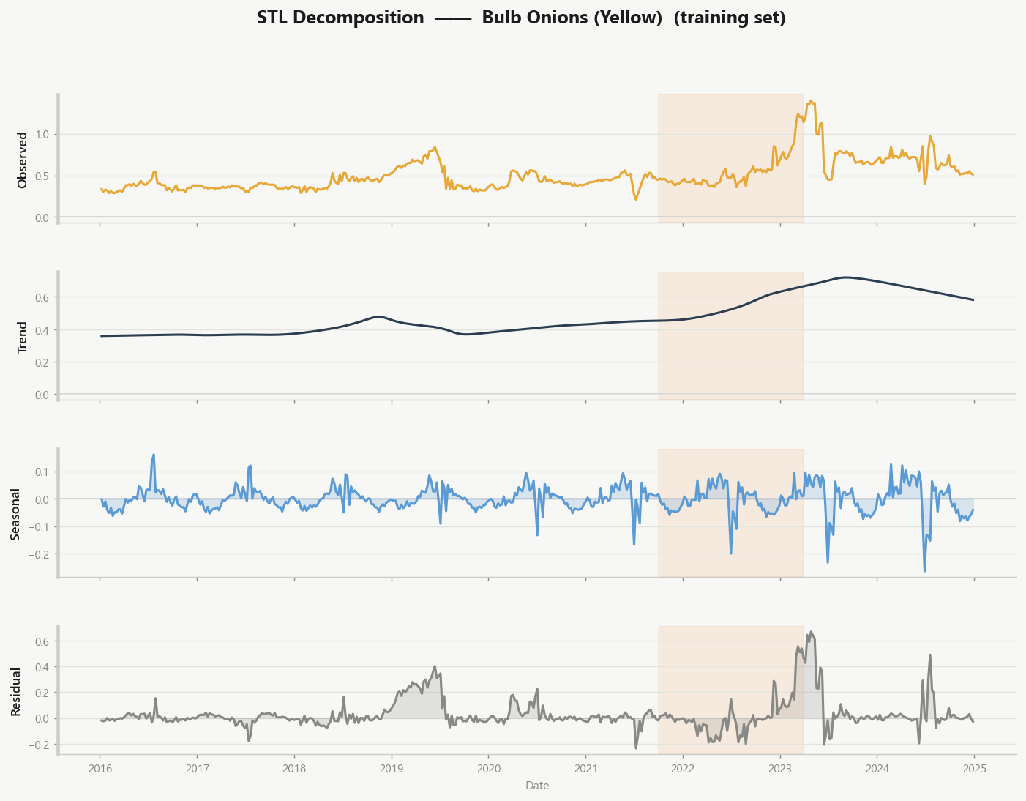
EDA Summary
Market Shock & Structural Seasonality
Severe Market Anomaly
Non-Stationary Baseline
Effective Differencing
Impact of Shock

Slide 5
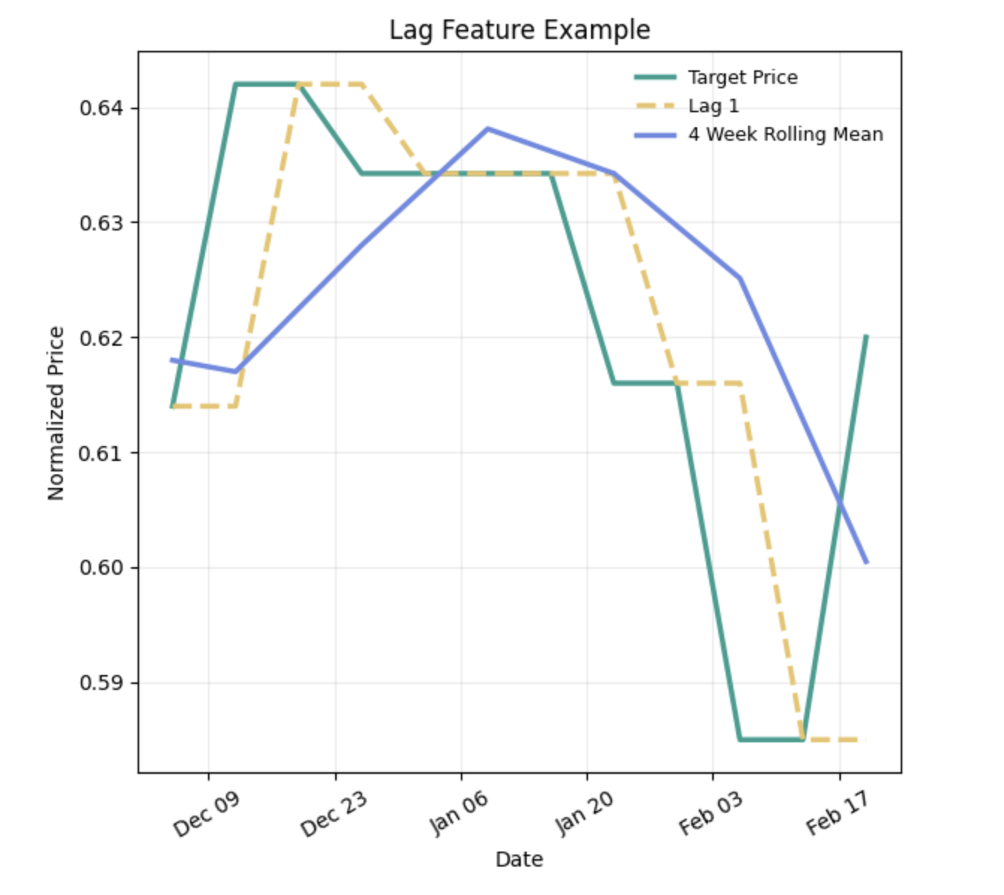
Data Engineering
Transforming raw price histories into predictive temporal features
Standardized multi-year commodity price data into a causal weekly forecasting panel.
Temporal features
Lag features
Rolling statistics
Year-over-year features
External drivers
Missing Data: Forward Fill to avoid data leakage

Slide 6
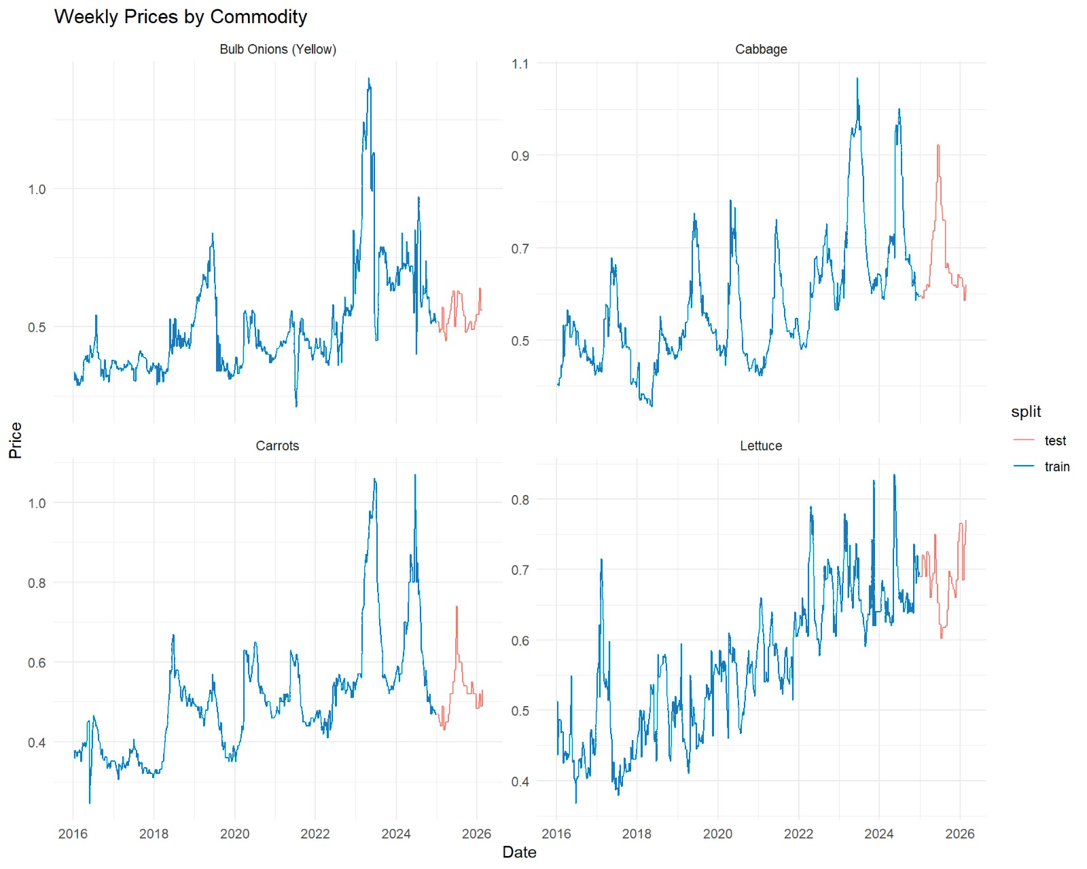
Evaluation Metrics
sMAPE provides a symmetric, scale-independent measure of forecast accuracy.
Symmetric error measurement – treats over- and under-prediction more evenly than MAPE.
Scale independent – allows comparison across commodities with different price levels.
Robust to volatility – handles large seasonal fluctuations common in fruit and vegetable prices.
More stable with small values – avoids extreme errors when prices are low.
Evaluated on the last 52 weeks of the data

Slide 7
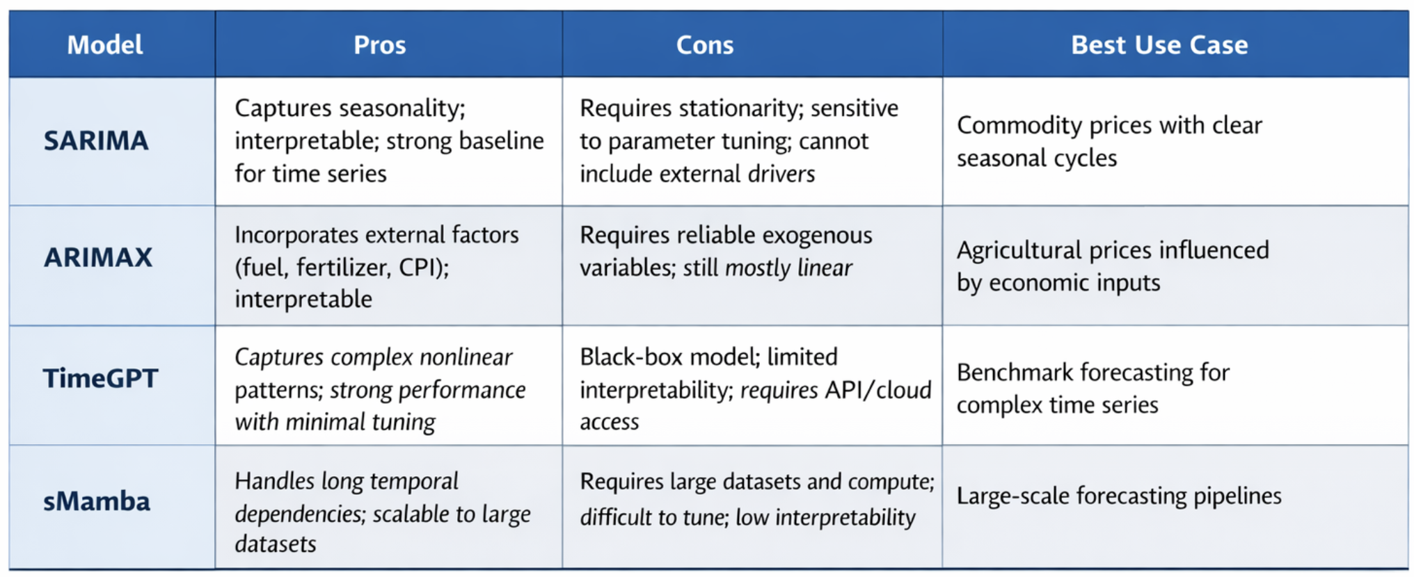
Modeling Selection
SARIMA/ARIMAX are interpretable; TimeGPT and sMamba capture complex patterns.
Goal: predict weekly UK wholesale vegetable prices for planning and budgeting
Data: DEFRA weekly prices + upstream material cost index as a cost driver
Challenges: strong seasonality, trend, missing weeks, and shock spikes
Success: best 52‑week rolling backtest accuracy (sMAPE)

Slide 8
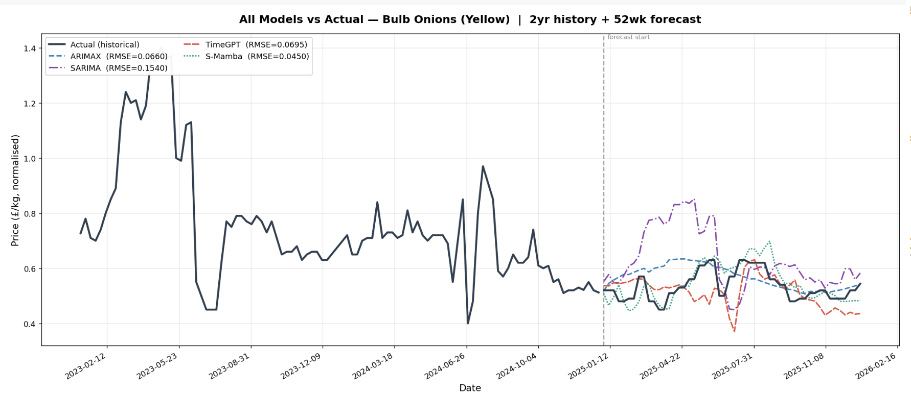
Model Performance Comparison

Slide 9
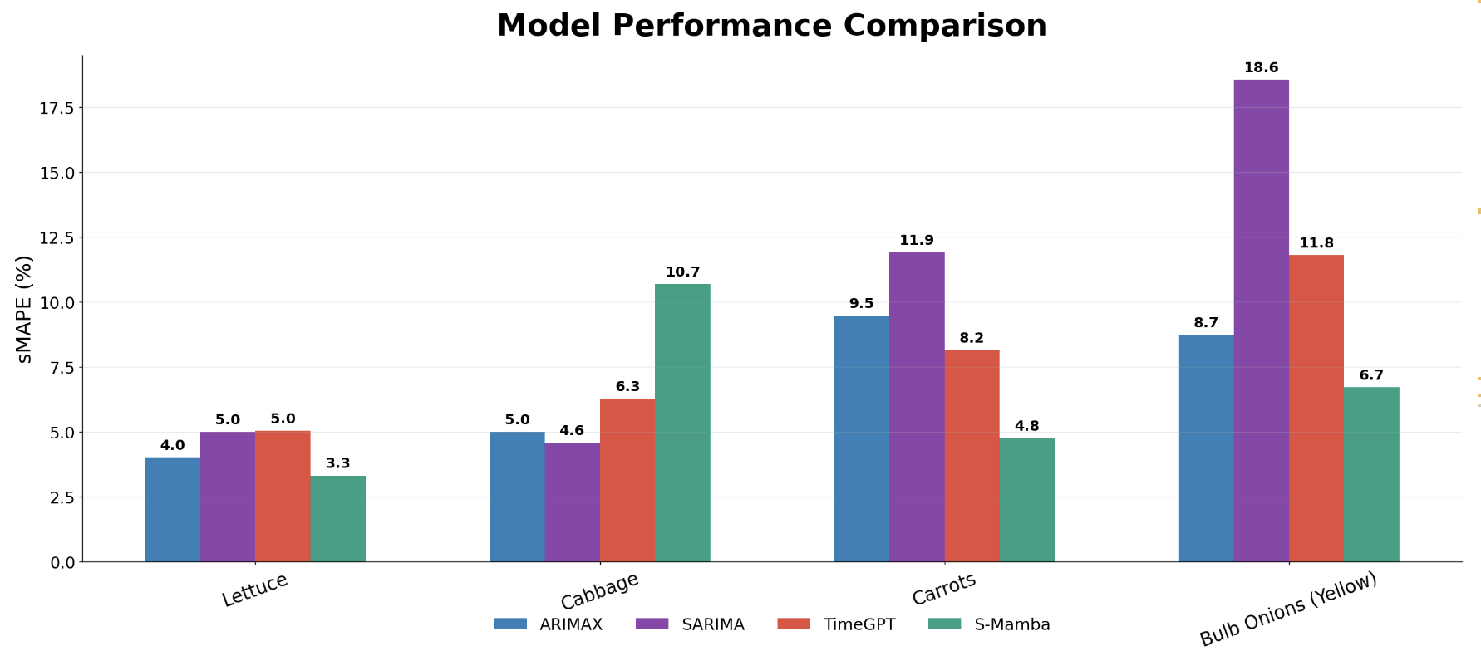
Model Performance Comparison
sMAPE Comparisons Between All Models

Slide 10
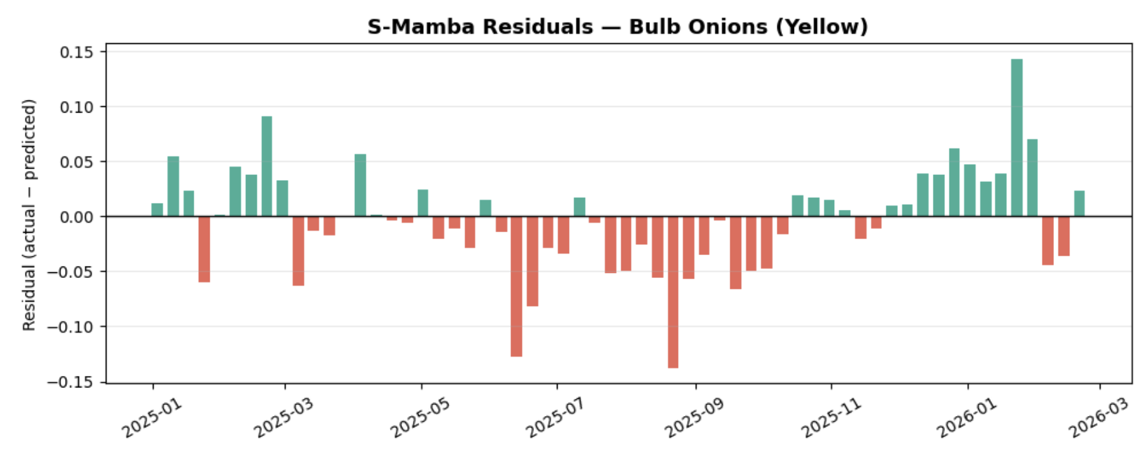
Final Model Selection
S-Mamba + SARIMA
Commodity | Best Model | sMAPE
Bulb Onions (Yellow) | S-Mamba | 6.72%
Cabbage | SARIMA | 4.60%
Carrots | S-Mamba | 4.77%
Lettuce | S-Mamba | 3.32%
Selected Final Model: S-Mamba
Based on the evaluation of sMAPE:
Captures temporal dependencies in commodity series.
It handles seasonality and structural shocks effectively.
It maintains low error across multiple commodities, showing strong generalization.

Slide 11
Impact & Applications
Acquired a Model to accurately predict market price of UK grocery items.
Supply Chain Planning:
Forecasts help wholesalers/retailers anticipate costs.
Budgeting & Cost Control:
Forward looking price expectations.
Market Risk Monitoring:
Identify price spikes early, allowing for easier response.
Historical Pricing + Cost Drivers
Forecast Model (S-Mamba/ SARIMA)
Weekly Price Forecast
Planning | Procurement | Risk Management
Notes:
This forecasting framework has practical applications for supply chains and market planning.
By predicting wholesale vegetable prices, the model helps businesses anticipate costs fluctuations driven by seasonality, supply disruptions and energy related production costs.
For wholesalers and retailers, these forecasts can improve procurement timing and budgeting decisions, reducing exposure to sudden price spikes.
They also provide an early signal of market volatility, allowing supply chain managers to adjust inventory strategies or contract purchasing ahead of price increases.
More broadly, this type of forecasting system can support food market monitoring and policy analysis, helping stakeholders better understand inflation dynamics in agricultural commodities.

Slide 12
Limitations and Future Work
Despite some limitations, the data supports modeling seasonal price dynamics.
Limitations
Missing data (Inherent limitation)
Frequency mismatch (Inherent limitation)
Limited commodity coverage
Residual is non-white noise
Future Work
Extend forecasting to all available commodities to improve coverage.
Incorporate additional exogenous drivers such as weather, import volumes, and retail demand indicators.
Explore higher-frequency external data to better align with weekly price observations.
Evaluate hybrid and ensemble models combining statistical and deep learning approaches.
Notes:
Limitations
Missing data: Approximately 9–13% of observations are missing due to holidays and changes in the reporting cycle, which may affect model stability.
Limited commodity coverage: Although 59 commodities are available, only four were modeled, limiting generalizability.
Frequency mismatch: Commodity prices are weekly, while exogenous variables are monthly or quarterly, requiring aggregation that may reduce temporal precision.
External factors not included: Weather shocks, supply disruptions, and import dynamics are not explicitly modeled.
Future Work
Extend forecasting to all available commodities to improve coverage.
Incorporate additional exogenous drivers such as weather, import volumes, and retail demand indicators.
Explore higher-frequency external data to better align with weekly price observations.
Evaluate hybrid and ensemble models combining statistical and deep learning approaches.

Slide 13

THANK YOU
https://github.com/Minhao-Zhang/ADSP_31006_Final_Project
Q & A

